Slide 1
Insurance Churn Classification
Iloegbunam Raymond

Slide 2
Business Problem:
You are an analyst for a health insurance company, and you want to analyze member data to predict whether a member reenrolls or “churns.” A member churns when he terminates his insurance coverage. Customer churn is a very important metric in business, and it is measured as the percentage of customers that stopped using a company’s product or service during a certain time frame.
As an analyst, you are tasked with identifying members who are at risk of churning. Once the potential churn members are identified, the member services department can preemptively intervene to retain the member.
Using historical claims data and demographic data, you will study re-enrollment for 2019.
You decide to develop a model to predict whether or not someone re-enrolled in 2019.

Slide 3
Dataset Description:
This dataset contains information on 4988 members of the health insurance company.
Variable | Description
memid | Member id
gender | M or F
isactive | Is the member active (claims in last year)? yes / no
maritalstatus | Married? yes / no
is_ppo | Is the member part of a PPO? yes / no
is_autorenewal | Is the member set up for auto-renew? yes / no
yearsenrolled | Number of years enrolled
Age | Age
claimsdenied | Number of claims denied
grievances | Number of greviances filed
Churned? | Churned means the member dropped the insurance policy
Variables:

Slide 4
CRISP-DM: Phase one Business understanding
Steps in Data Mining
1) | Business Understanding
1.1 | Determine the business objectives.
1.2 | Determine the data mining goals.
What is the primary objective, from a business perspective?
To reduce the Churn rate of customers
What is the primary objective, from a technical perspective?
Build a classification model that predicts customers who are at the risk of churning based on historical claims and demographic data
Outcome variable, if relevant:
churned

Slide 5
dATA understanding
ANSWERS HERE:
2.3 a. List of variables with variable type.
2.3 b. Incorporate domain knowledge. Do you need to remove or combine any variables?
Variable | Variable Type
memid | String
gender | Categorical
isactive | Categorical
maritalstatus | Categorical
is_ppo | Categorical
is_autorenewal | Categorical
yearsenrolled | numerical
Age | numerical
claimsdenied | numerical
grievances | numerical
Churned? | categorical

Slide 6
DATA UNDERSTANDING – Explore Data
Univariate Analysis of Predictor Variables
In any of the variables: Are there any missing values?
Are there any extreme values for numerical variables?
Are there too few observations in any level of the categorical variables?
Any other concerns with the data?
Answer:
None
Answer:
None
Answer:
12 people are not on autorenewal
Only 12 people are NOT on autorenewal; No members in the age rage of 49-56.
;
Answer: There are values for members with low age, as low as 1
Only 5% (25 people) are not active; low frequency for values of “claims denied” > 0; low frequency for values of “grievances” > 0;

Slide 7
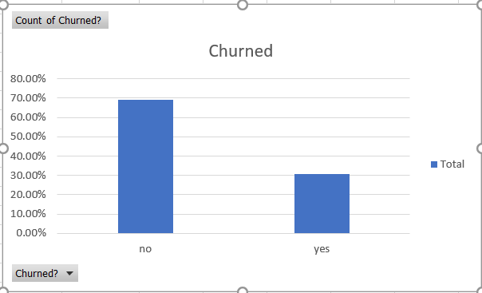
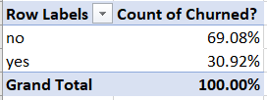
Univariate Analysis of Outcome Variable
For the outcome variable, include the following on this slide: Pivot Table of the outcome variable showing frequency and percent frequency; and bar graph of frequency (or percent frequency).

Slide 8
Bivariate Analysis
DATA UNDERSTANDING – Explore Data
Choose two categorical predictor variables. Make one slide for each variable.
Create a pivot tables showing the outcome variable on the columns crossed with the categorical predictor variable on the rows. Show frequencies and percents by row total.
Create pie charts of each categorical predictor variable versus the categorical outcome variable showing percent frequencies

Slide 9
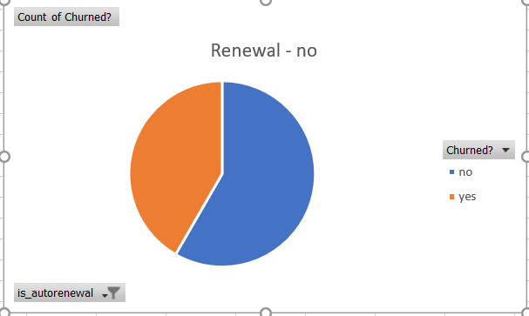
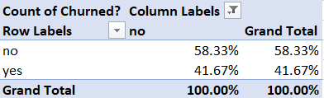
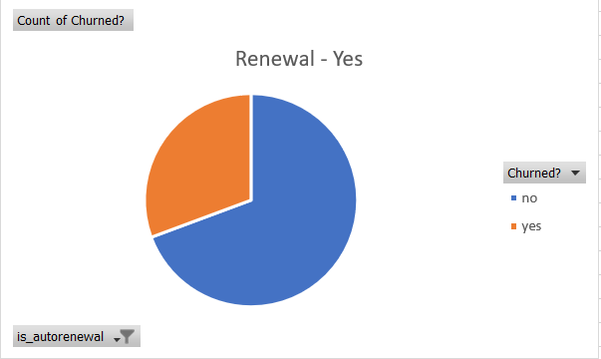
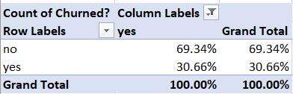
Categorical Predictor Variable #1

Slide 10
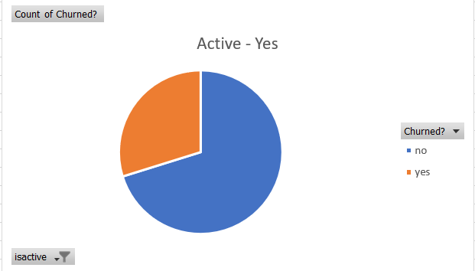
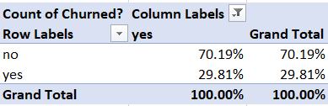
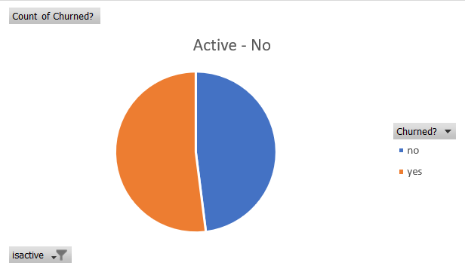
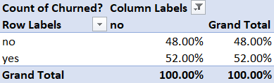
Categorical Predictor Variable #2

Slide 11
Based on your bivariate analysis, Categorical/ordinal variable that seems best for predicting the outcome variable Suggested variable with reasoning:
Best categorical/ordinal variable: Isactive – It shows if the member has been active(claims in last year)
Reasoning: The pie chart shows we have more ‘No’ churns for active members and high churn rate for inactive members

Slide 12
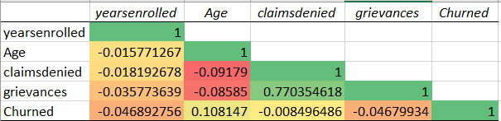
Bivariate Analysis – Correlation Matrix
Using the numerical predictor variables and the Churned_Indicator variable, create a correlation matrix and copy it below.
Include conditional formatting.
Note which variables have a strong relationship to the outcome variable, and state whether it is a positive or negative relationship.
Note strong relationships with outcome variable here:
From the correlation matrix, the age variable is seen to have the stronger correlation amongst others even though it’s a weak positive correlation

Slide 13

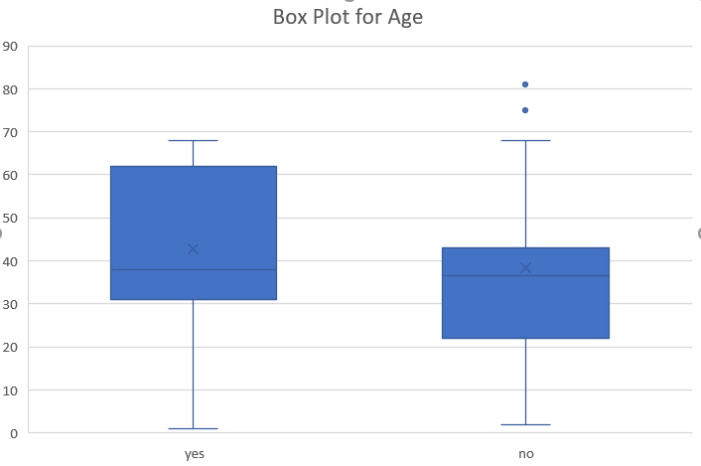
Numerical Predictor Variable #1

Slide 14
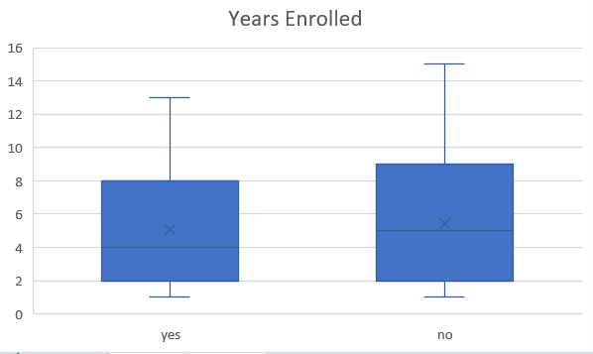
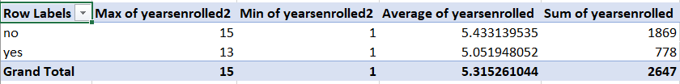
Numerical Predictor Variable #1

Slide 15
Best numerical variable: Age
Reasoning: The age variable tells us the range of the age of those that are likely to churn or not. We can see that people in their early 20’s up to their early 40’s are not likely to churn unlike those older. It can be interpreted as, the older people get the less likely they are to get insured.

Slide 16
Which variables that might be useful in predicting the outcome variable
List of Predictors:
List the recommended predictor variables (including the best categorical and numerical variables already identified in previous slides).
Is active
Autorenewal
Age
Yearsenrolled

Slide 17
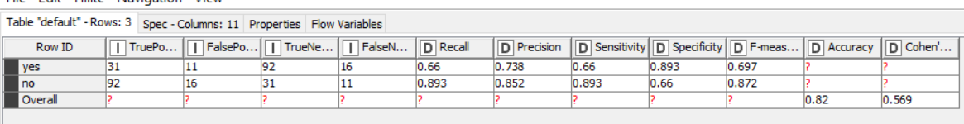
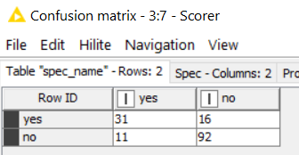
CRISP-DM: Phase 4 MODELING: Model 1 – Decision Tree

Slide 18
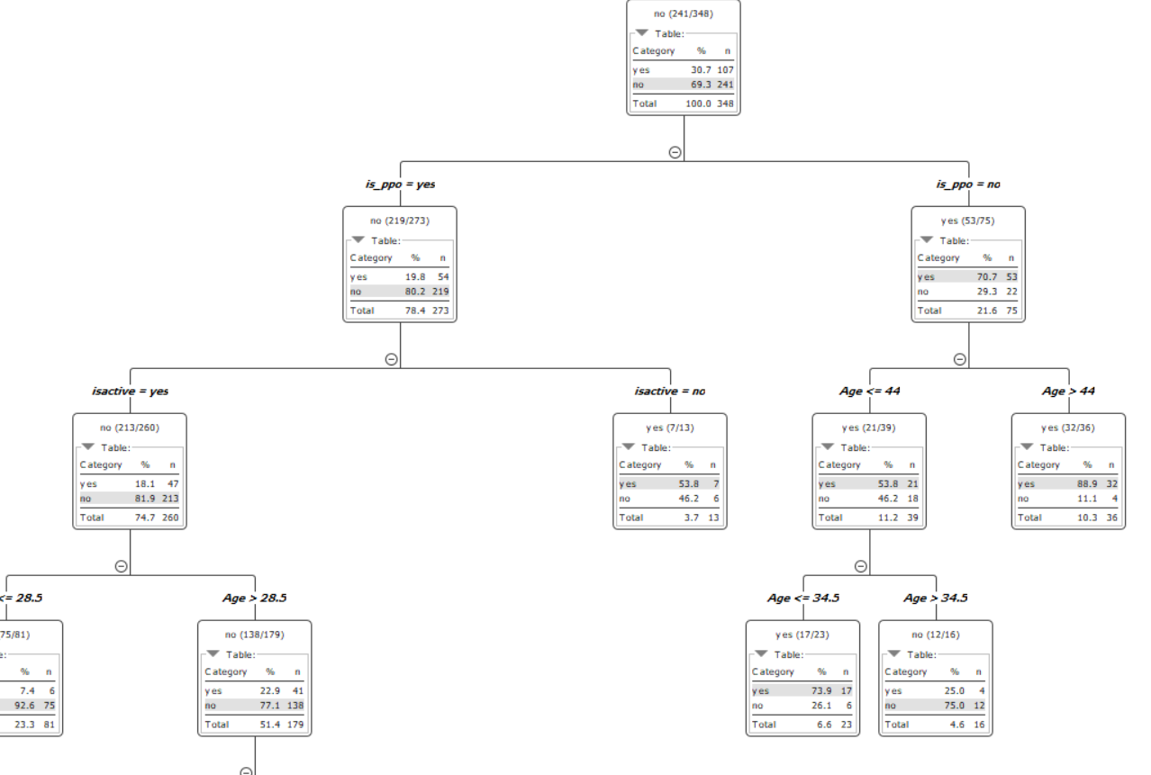

Slide 19
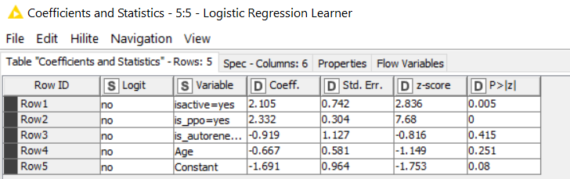
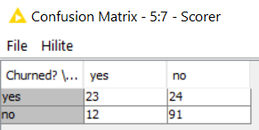
Model 2– Logistic Regression

Slide 20
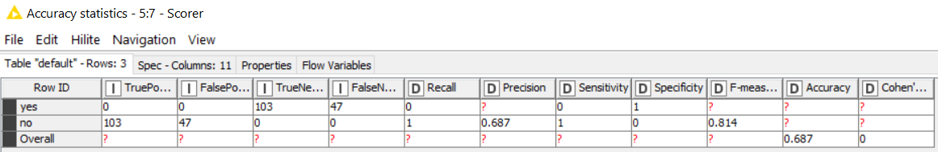
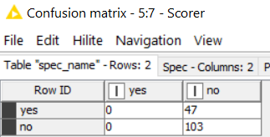
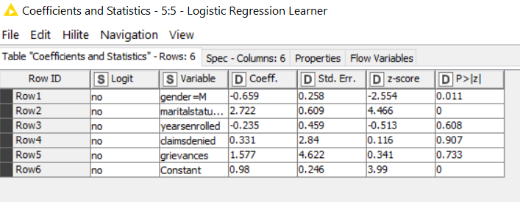
MODELING: Model 3 – Logistic Regression
ALL Predictors

Slide 21
MODELING
Recommended model: The Decision tree remains the most recommended model
Reasoning: Aside the fact that it has the highest accuracy and recall, it also has the lowest False Negative(which is of interest to us) and False positive values

Slide 22
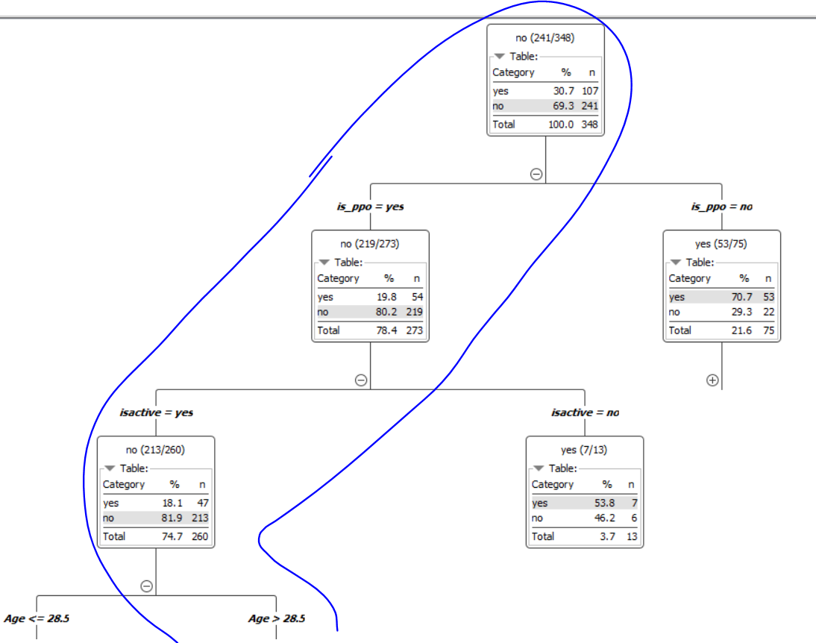
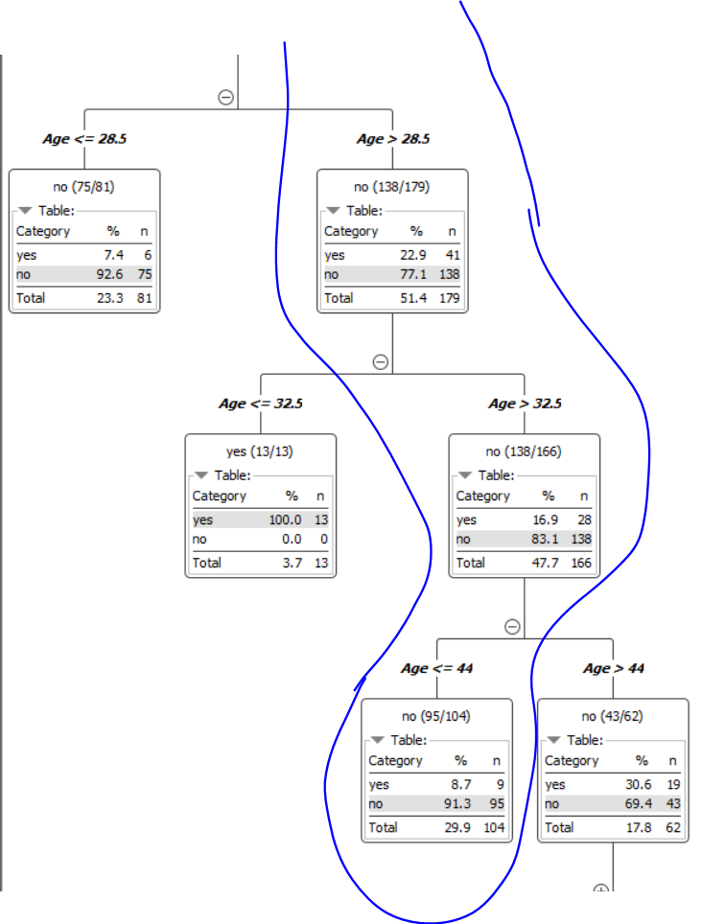

Slide 23
MODELING
Based on my four models, these variables seem to be the strongest predictors of churn.
Variables that best predict churn based on model results:
Isactive
age
Maritalstautus
Is_ppo
grievance
These variables have the strongest predictor based on our model.
In the decision Tree, it represent the top nodes for the decision tree(is_ppo and age) while they have the highest coefficient for the logistic regression

Slide 24
MODELING
Based on the variables I found to be the strongest predictors of churn, these are my recommendations
Run targeted campaign and discounts(to the age bracket I specified) to make sure members are part of a PPO and keep them actively using the insurance.
Also, improve quality of service to customers to reduce grievance

Slide 25
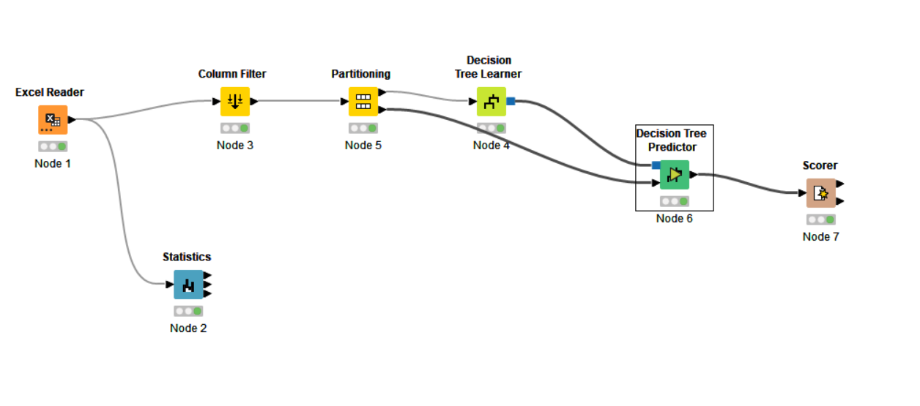
MODELING
Screenshot of your KNIME workflow for Decision Tree here.

Slide 26
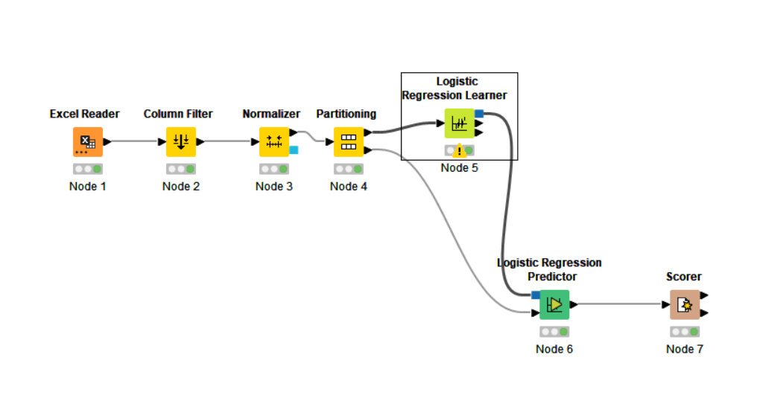
MODELING
Screenshot of your KNIME workflow for Logistic Regression here.

